Slide 1


Unpacking Patient Drug Reviews

Slide 2






Network
Analysis
Our
Team
Mounika Yallamandhala
Sri Durga Nidadavolu
Vamsi Gopala Krishna Kethepalli
Lakshmi Neelima Krishnagiri

Slide 3


Data Set Description
Variable | Type | Description | Description
uniqueID | Numerical | Identifier of the review | Identifier of the review
drugName | Categorical | Name of the drug | Name of the drug
condition | Categorical | Medical condition being treated | Medical condition being treated
review | Text | Text of the review | Text of the review
rating | Numerical | User rating for the drug | User rating for the drug
date | Date | Date of the review | Date of the review
usefulCount | Numerical | Number of users who found the review useful | Number of users who found the review useful
Total records – 215,063

Slide 4


Motivation
LEARNING EXPERIENCE ON NLP
DRUG FEEDBACK AND IMPROVEMENT
It’s real-world business impact.
POPULAR DRUGS USED BASED ON CONDITIONS
CUSTOMER ENGAGEMENT

Slide 5

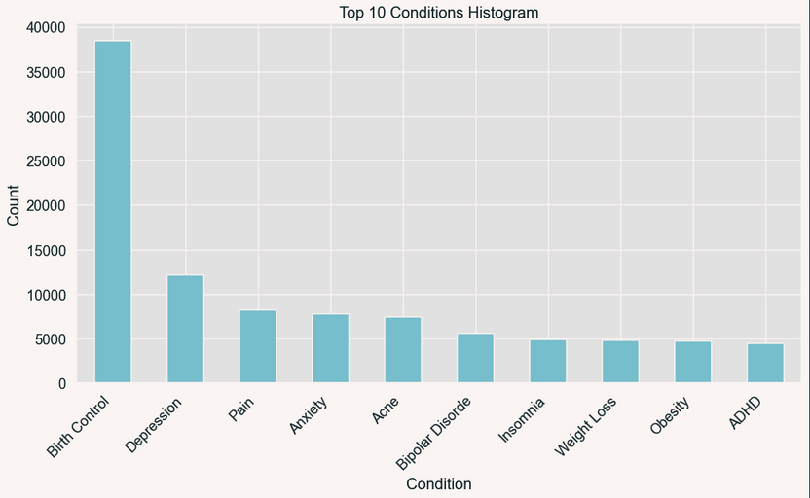
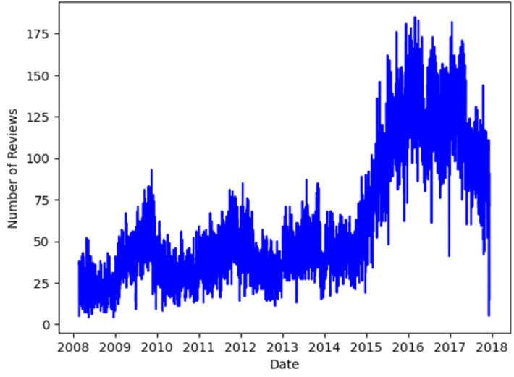
Exploratory Data Analysis
REVIEW TRENDS OVER TIME WITH DAILY VARIANCE​
TOP 10 HEALTH CONDITIONS

Slide 6
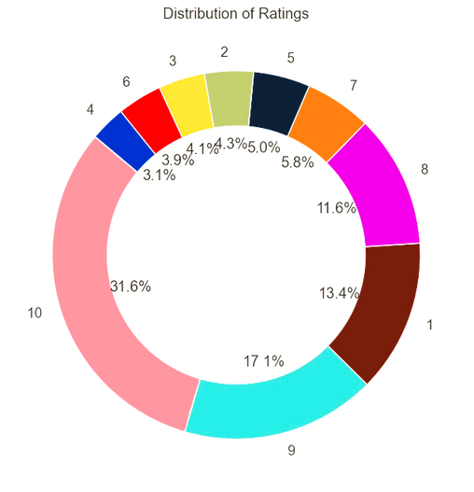
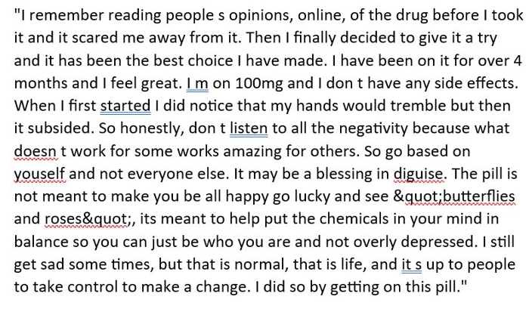
Exploratory Data Analysis
DISTRIBUTION OF RATINGS

Slide 7
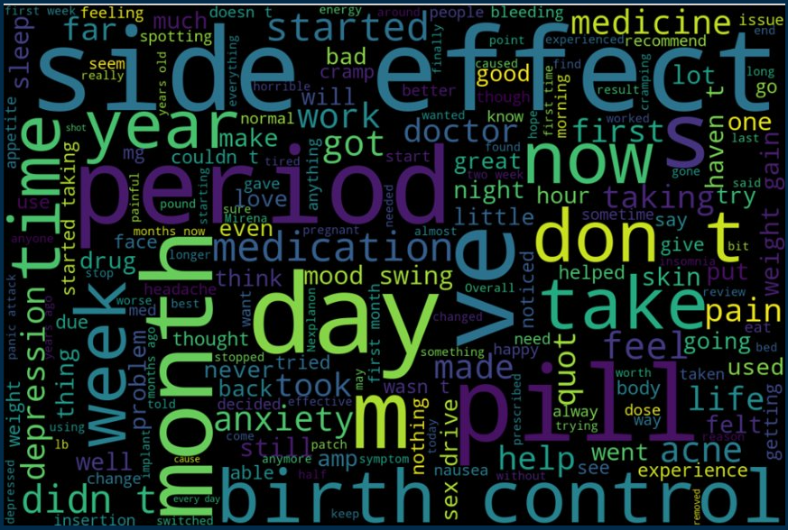
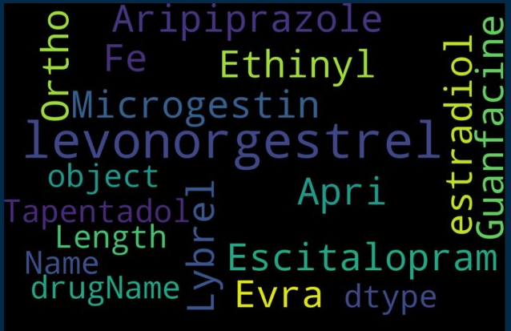
Word Cloud
REVIEWS
DRUGS

Slide 8



Data Preprocessing
REMOVED NULL VALUES​
DATA CLEANING - REMOVED SPECIAL CHARACTERS, STOP WORDS, JUNK CHARACTERS AND REPEATING PATTERNS​
FILTERED FOR TOP 10 CONDITIONS (> 4000 REVIEWS)​
REVIEWS TOKENIZATION
CATEGORICAL VARIABLES(LABEL ENCODING)​

Slide 9
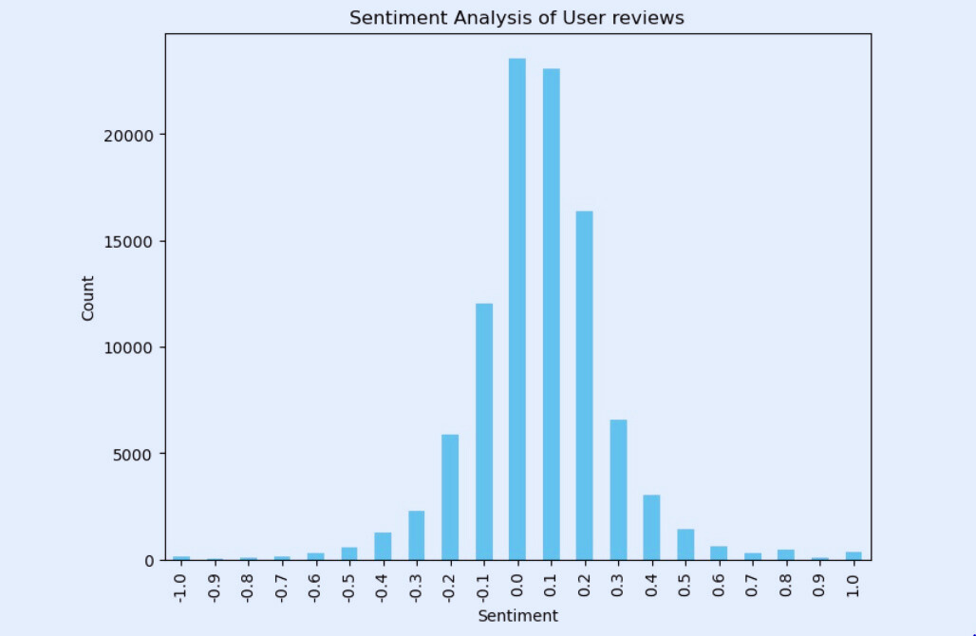
SENTIMENT ANALYSIS
+1 SENTIMENT SCORE
LIBRARY – TEXTBLOB
"I HAVE TAKEN A LOT OF DEPRESSION MEDICINES OVER THE YEAR;S BUT THIS ONE HAS WORKED THE BEST FOR ME. I TAKE 250MG A DAY AND THE SIDE EFFECTS HAVE BEEN VERY MINIMUM."
-1 SENTIMENT SCORE
"one of the worst medication ever causes nightmare and makes u depressed and panicky"

Slide 10


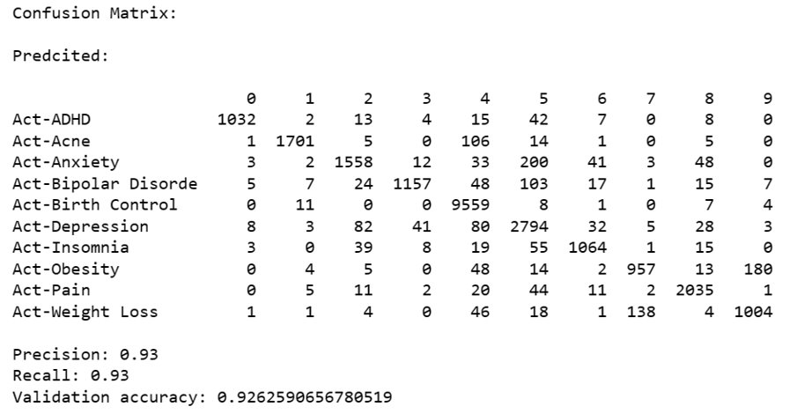
Predictive Modeling
Random forest Classifier
PREDICT PATIENT CONDITION FROM PATIENT REVIEW
31362 COLUMNS AFTER TOKENIZING
Model | Accuracy
Logistic Regression | 88.1
Random Forest | 92.6
XgBoost | 89.5

Slide 11
Predictive Modeling
FEATURE REDUCTION
BASED ON FEATURE IMPORTANCE​
PCA – DIMENSION REDUCTION
Important Features
Feature​ | Importance​
Pain​ | 0.038​
Period​ | 0.030​
Birth​ | 0.026​
Acne​ | 0.023​
Anxiety​ | 0.023​
Model​ | Accuracy​
Random Forest (31k columns)​ | 92.6​
Random Forest ( Feature imp. threshold > 0.0001 - 1245 columns)​ | 92.5​
Random Forest ( Feature imp. threshold > 0.001 - 197 columns)​ | 91.5​
Random Forest ( PCA – 200 columns from 1245 features) ​ | 91.3​
Random Forest ( PCA – 150 columns from 1245 features) ​ | 91.2​

Slide 12
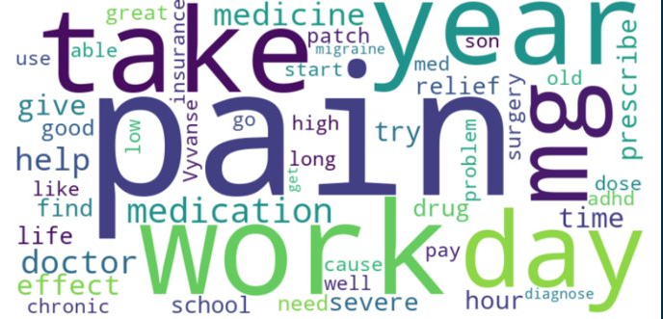
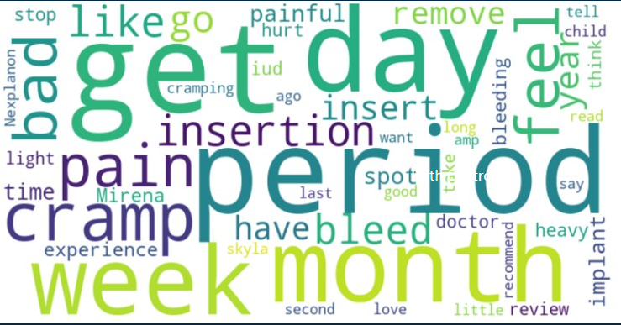
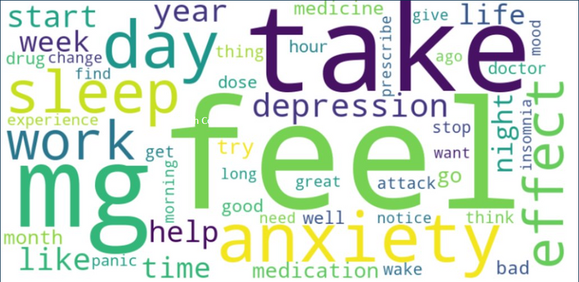
Topic Modeling
GENERIC
CONSIDERATION OF TOP 10 CONDITIONS​
LIBRARIES USED: SPACY, GENSIM​
BIRTH CONTROL
LDA MODEL​
SPLIT INTO 5 DOMINANT TOPICS
DEPRESSION
&
ANXIETY

Slide 13
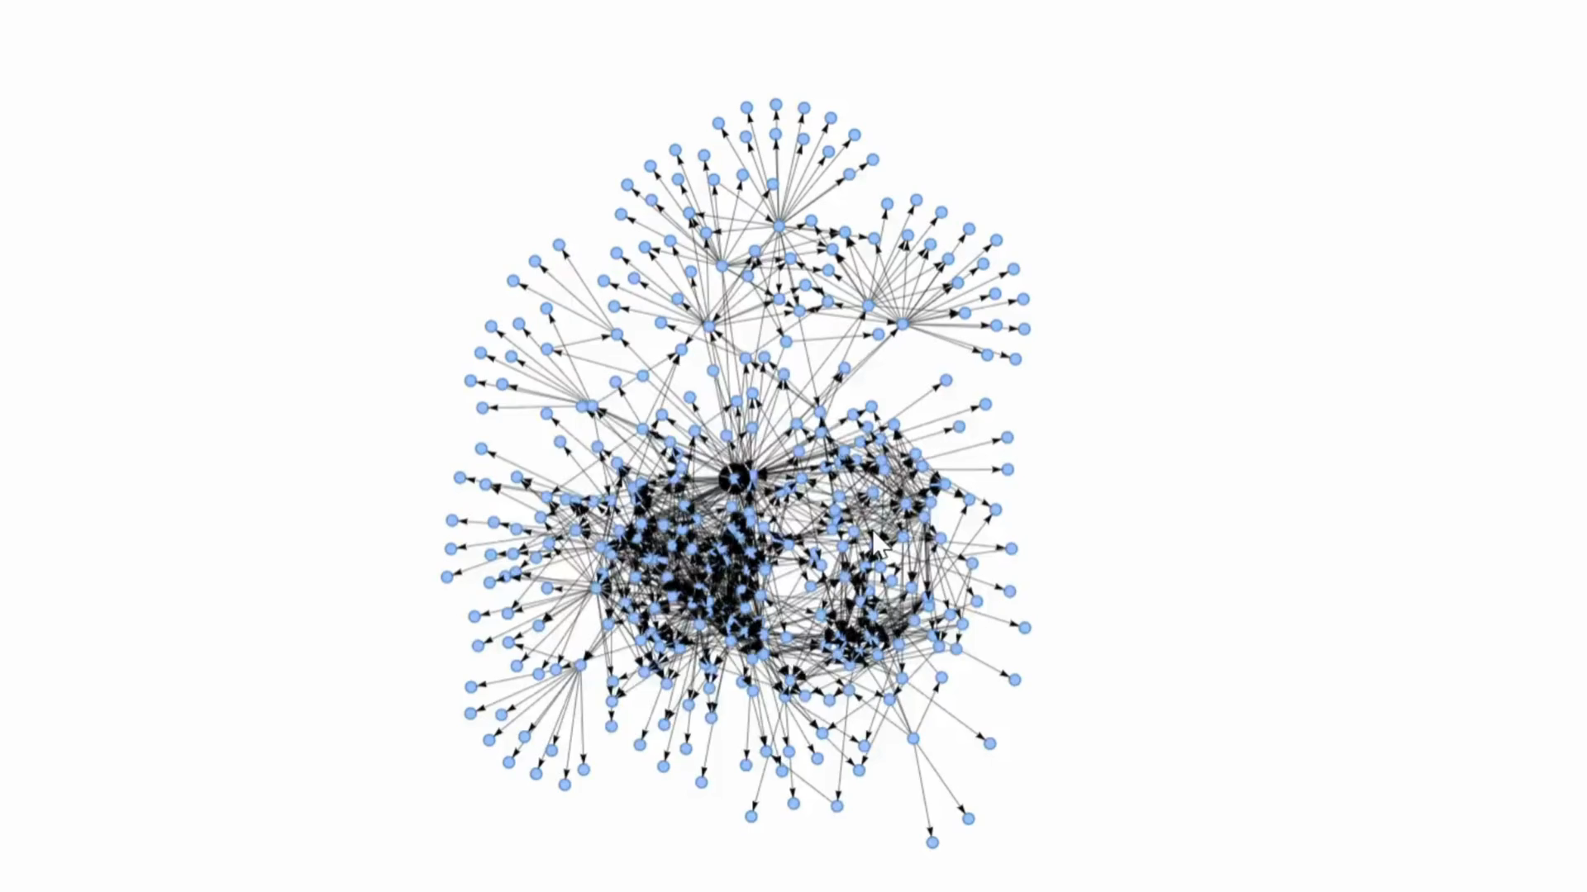
Condition Drug
Network

Slide 14
Critical Aspects of Dataset
IMBALANCED DATA
HIGH VOLUME DATA
COMPUTATIONAL HEAVY
DATA SCALING
FEATURE ENGINEERING​

Slide 15
Key Take Aways
SENTIMENT ANALYSIS - HIGH NEUTRAL REVIEWS
FIVE DOMINANT TOPICS USING SUCCESSFUL TOPIC MODELING TECHNIQUES.
EVALUATED LOGISTIC REGRESSION, RANDOM FOREST, AND XGBOOST MODELS FOR PREDICTIVE PERFORMANCE.
NETWORK ANALYSIS OF CONDITION – DRUG RELATIONSHIPS

Slide 16
Future Scope
DEEP LEARNING, ENSEMBLE METHODS
REAL-TIME DRUG SUGGESTIONS VIA VIRTUAL MEDICAL ASSISTANT
EXPLORE REAL-TIME INTEGRATION OF REVIEWS WITH PREDICTIVE MODELS FOR CONTINUOUS MONITORING AND RESPONSE.

Slide 17

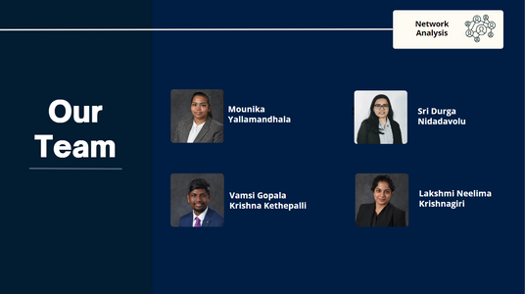
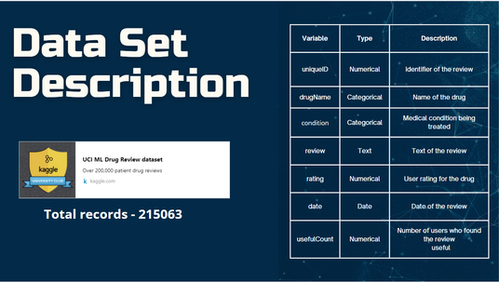

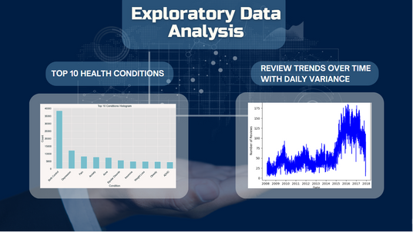
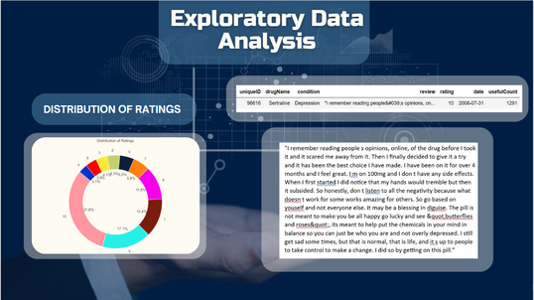
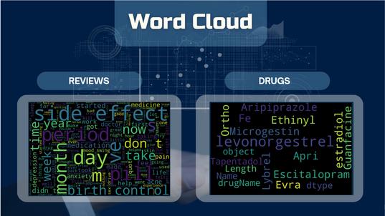
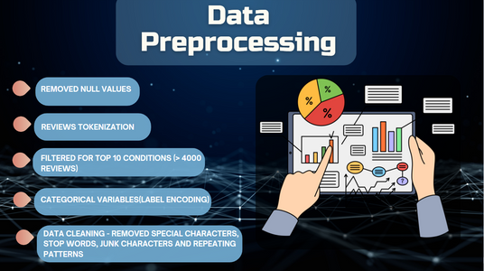
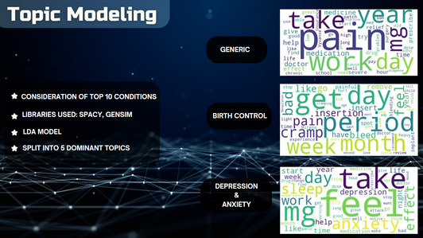
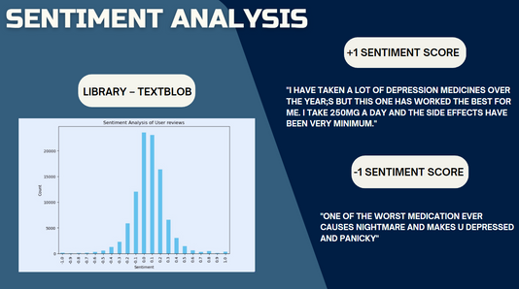
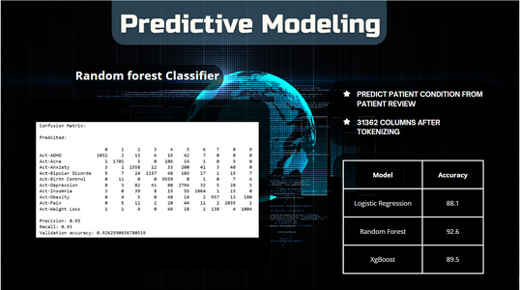
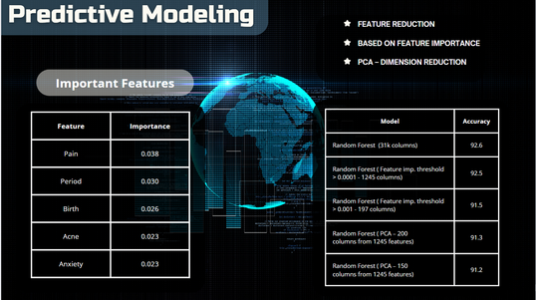

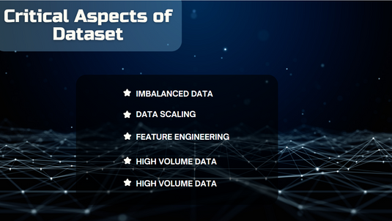
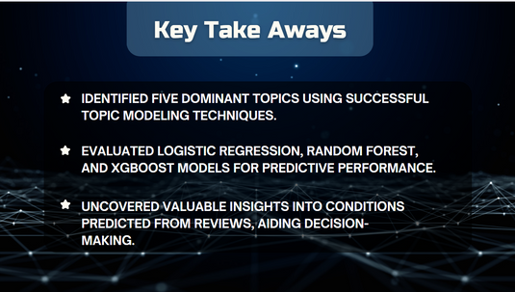
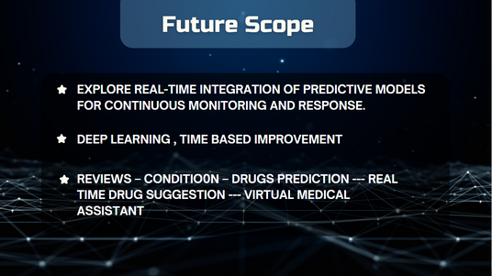
Summary

Slide 18

Thank You
Questions?

